Slide 1
Subject :- Cyber Law
Faculty :- moinuddin Quraishi
Janavi Siddhapura
Aditi Prajapati
Princy Patel
Pooja Bera

Slide 2
PATENT :-
Patent means an official document giving the holder of the patent sole right to make,use or sell an invention and preventing others from imitating it.Patents generally granted to ‘inventions’.
A person owning a patent over a certain product or process has the sole right to use the product or process.He/She is entitled to pursue a claim against another person using such a product or process without prior permission.

Slide 3
A patent is a right granted for any device,substance,method or process which is new,inventive and useful. A patent is legally enforceable and gives the owner the exclusive right to commercially exploit the invention for the life of the patent.
The legel right is not automatic,one has to apply for a patent.All applications for patents are examined to ensure that they meet the necessary legal requirements for granting a patent.Patents give effective protection if one has invented new technology that will lead to a product,composition or process with significant long term commercial gain.
One cannot patent artistic creations,mathematical models,plans,schemes or other purely mental processes.

Slide 4
PATENT ACT
PATENT ACT, 1970
Amended in ..
1999
2005
2002

Slide 5
INDIAN PATENT ACT, 1970 (AMENDED TILL 2005)
The various patent (amendment) bills (1999-2005) are the culmination of all the research efforts and consultation by the government.some of the objectives of the bills are:
To define the term ‘invention’ in consonance with international practices and consistent with TRIPS Agreement.
To modify section 3 of the present act to include exclusions permitted by the TRIPS agreement and also subject matters like discovery of any living or non-living substances occurring in nature in the list of exclusions which in general do not constitute patentable invention.
To align the rights of the patentee with article 28 of the TRIPS agreement.
To add provision for reversal of burden of proof in cases of infringement suits on process patents in accordance with article 34 of the TRIPS agreement.

Slide 6
e.
To provide a uniform term of patent protection of twenty years for all categories of inventon as per article 33 of the TRIPS agreement.
f.
To align the provisions relating to compulsory licensing and omit provisions relating to licensing of rights.
g.
To provide provision relating to the parallel import of patented products.
h.
To make provision for enabling persons other than the patent holder to obtain marketing approval from the appropriate regulatory authorities within three years before the expiration of the term of the patent.
i.
To incorporate measures for protection of biodiversities and traditional knowledge.

Slide 7
j.
To provide an appellate board for speedy disposal of appeals and rectification of the register of patents which at present lie before high court.
k.
To amend the provisions relating to national security.
l.
To amend several provisions of the act with a view to simplifying and rationalizing the procedures aimed at benefiting users.
India is commited to making its patent laws compatible with the trade – related aspects of intellectual property rights (TRIPS) agreement under WTO by 2005 and have incorporated all changes in patent act,1970 through various amendments as listed above.these changes will cause a paradigm shift in the thinking of the intellectual property managers and inventors.

Slide 8
THE SILENT FEATURES OF THE ACT
Applicability of product patent from January 01,2005.
Term of the patent for all inventions has been extended to 20 years from the date of the application.this includes inventions relating to chemical process,food,druges.
Patent applications will be published after 18 months from the date of application.the new system envisages double publication.the first time after 18 months and the second time after acceptance.
In relation to computer programs,object-oriented software will now be patentable .what continues to be not patentable is a computer program per se or an algorithm.

Slide 9
There must be a single patent in respect of single invention
Patent must be in respect of invention.
Patent may be in respect of a substance or a process.
Patent cannot be divided into parts by saying that one connects to substance and other to the process.
Claim alone constitutes the patent.
A new definition of ‘Invention', which refers to a new product or process involving inventive step and capable of industrial application, has now come in force.

Slide 10
A method or process of testing during the new process of manufacture will now be patentable.
Process defined in case of manufacturing plants are now patentable, while a process for diagnostic and therapeutic has now been considered as non-patentable,
Time for restoration of a ceased patent, has now increased from 12 months to 18 months.
Time for putting the application in order for acceptance has now been reduced from 15 or 18 months to 12 months.

Slide 11
Which inventions are not patentable?
invention that is frivolous or that claims anything obviously contrary to the well established natural laws.
invention, the primary or intended use of which would be contrary to law or morality or injurious to public health.
mere discovery of a scientific principle or the formulation of an abstract theory.
mere discovery of any new property or new use for a known substance or a known process, machine or apparatus unless such known process results in a new product or employs atleast one new reactant.

Slide 12
substance obtained by a mere addition of mixture resulting only in the aggregation of the properties of the components thereof or a process for producing such substance.
mere arrangement or rearrangement or duplication of known devices, each functioning independently of one another in a known way.
method or process of testing applicable during the process of manufacture for rendering the machine, apparatus or other equipment more efficient, or for the improvement or restoration of the existing machine, apparatus or other equipment, or for the improvement or control of manufacture.
method of agriculture or horticulture.

Slide 13
Opposition to grant a patent
In the new amendment, some fundamental changes have been incorporated with regard to ‘opposition procedure’ in an attempt to speed up the grant of patent. Earlier any person could oppose the grant of patent by initiating opposition proceedings and the opponent had the right of audiences in such a procedure, prior to the grant of patent. Any person could merely make written repesetation to the patent authorities against grant. The earlier law did not provide for any opposition procedure once the patent was granted, but only right to apply for revocation. The new ordinance introduces a system of opposition, which can be initiated within a period of one year, post-grant of patent. This is in addition to the revocation procedure, which is already in place but the only differences is that the same needs to be filed before the newly constituted Appellate Board, unless such revocation procedures are way off a counter attack in a High Court infringement suit.

Slide 14
Rights prior to the grant of patent
From the date of publication of the application to the date of the grant of a patent, the applicant has the like privileges and rights as if a patent for the invention has been granted on the date of the publication of the application.
However, applicant is not entitled to institute any proceedings for infringement until the patent has been granted. Prior to the Third Amendment, only upon acceptance of theapplication did the applicant enjoy like privileges and rights.

Slide 15
Secrecy provisions
Obtaining written permission of the Controller of Patents.the Controller is required to obtain consent of the Central Government before granting such permission for inventions relevant for defence purpose/atomic energy. The application is to be disposed of within 3 months, or
Patent application for the same invention has been first filed in India at least sİx weeks before the application outside India and there is no direction passed under Section 35 prohibiting/restricting publication/communication of information relating to the invention.

Slide 16
Terms and conditions of granting compulsory licence:
The Controller should ensure that the patented invention worked to the fullest potential and is providing reasonable profit to the person to whom the licence is granted.
The Controller should ensure that the patented article is made available to the public at a reasonable price.
The Controller should ensure that the royalty and any other remuneration reserved for the patentee is reasonable,keeping in view the expenditure incurred and nature of the invention.

Slide 17
PATENT FOR COMPUTER SOFTWARE
Software intellectual property, commonly known as software IP, is a computer program or code that is protected by law from unauthorized copying, theft, or other uses. The corporation that generated or obtained the rights to that code or software owns the intellectual property (IP)associated with it. It is prohibited for someone else to use it without your permission. Sourcecode and object code are two types of computersoftware. Software development requires a lot of talent, time, and effort, so it's only reasonable that you want to preserve all of your hard work.Unauthorized individuals can copy and usecomputer programs.
It is possible to patent programmes for computers which, when runon a computer produce a "technical effect". However, if a programme does not produce such an effect, it is unlikely to be patentable. A technical effect is generally an improvement in technology and needs to be in an area of technology which is patentable.

Slide 18
For instance, an improved programme for translating between Japanese and English is not patentable because linguistics is a mental process, not a technical field. On the other hand, a programme which speeds up image enhancement may be patentable because it produces a technical improvement in a technical area.The recent amendment to Indian Patent Act allows patents for softwares with industry application. This is sought by restricting non-patentability to computer program per se.

Slide 19
PATENT FOR BUSINESS MODEL
Earlier in the US, patents were not given to 'methode of doing business and mathematical algorithm and these were exceptions developed by courts as limitations on the grant of process patents.
However, in the last few years, American courts have taken lead for the recognition of patent for business models. The US courts have rejected business models involving mathematical processes as they are too abstract and are unable to be reduced to a tangible form. The patent claims for an accounting method comprising the steps for entering, sorting, debiting and totaling expenditures and printing an analysis statement were rejected on the grounds that the claims pre-empted a mathematical algorithm for calculating expenses.

Slide 20
PATENT FOR INCREMENTAL INNOVATION
Sectio 3(d) under Chapter 2 of Indian Patent Act does not grant patent to incremental innovation. For example, for a new method employed in Pukapuraa –a smoke house used to dry rubber sheets- would require 60.5% less fuel, a patent cannot be granted as it is improvement over the old process. Similarly, for modified drug fomulation to be eligible for grant of patent, it should exhibit enhanced therapeutic efficacy over the older version, otherwise it. Is considered as incremental innovation and hence it cannot be patented. In the another case under the Section 3(d), a multinational pharmaceutical company Novartis was denied a grant of patent for its modified anti-cancer drug – Glivie - based on the platform of incremental innovation lacking in significant improvement in its efficacy.

Slide 21

Trademark Act 1999
The Trademark Law in India is now contained in the provisions of Trademark Act, 1999(47 of 1999).The earlier Trade & Merchandise Mark Act, 1958 has been repealed. The object of this Act is to confer protection to the user of the trademark on his goods and prescribe condition for acquisition, and legal remedies for enforcement of Trademark rights.
The definition of trademark as define in the Indian Trademark Act means a registered trademark or mark used to identify the origin and manufacture of the goods.
The Indian Trademark Act,1999 provides for registration of trademark with the Registrar of Trademark . For the purpose of registration of the trademark, India has been divided into four zones. The trademark offices are located in Mumbai, Delhi, Kolkata and Chennai.

Slide 22
Object of Trademark Act 1999
Control Passing-off
Publish
World Wide
Covered all Category
Object of Trademark Act 1999
Protect Well Known TM
User Friendly
Easy to Apply

Slide 23

TYPE OF TRADMARK:-
Trademark:-
-> A trademark includes any word, name, symbol or device or any combination, used, or intended to be used, in commerce to identify manufactured or sold by others, and to indicate the source of the goods. In short, a trademark is a brand name.

Slide 24

2. Service Mark:-
-> The new definition of ‘service mark’ has been included for the benefit of service-oriented establishments such as banking, communication, Education, finance, insurance, chit funds, real estates, transport, storage material treatment, processing, supply of electrical or other energy, boarding, lodging, entertainment, amusement, construction repair, conveying of news or information and advertising.
Ex:- McDonald’s have a series of ‘MC’ registered as word mark which represents their different product range such as Mc Chicken, Mc Veggie etc.

Slide 25
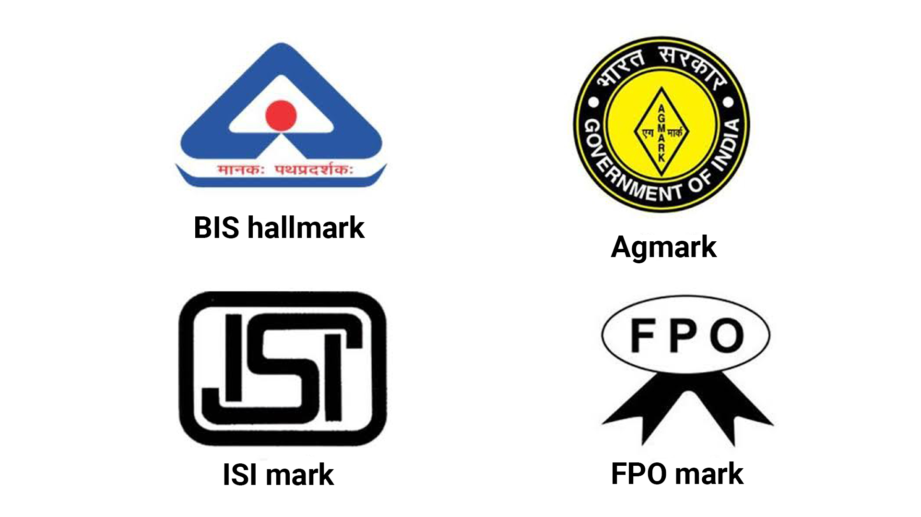
3. Certification Mark:-
A certification mark is any word, name, symbol, device, or any combination, used or intended to be used in commerce with the owner’s permission by someone other than its owner, to certify regional or other geographic origin, material, mode of manufacture , quality, accuracy, or other characteristics of someone’s goods or serv- ices, or that the work or labour on the goods or services was performed by members of a union or other organization. The example of certificate marks are ISI, AGMARK, etc.

Slide 26

4. Collective Mark:-
-> The new definition for ‘well known trademark’ has been provided for the benefit of a trademark being used by the substantial segment of the public.
-> Collective marks are used to identify members of an organization comprising manufacturing, commercial or service activities.
Ex:- A chartered accountant can use the “CA” Device as he is a registered member of the Institute of Chartered Accountants.

Slide 27
Well known trademark:
The new definition for ‘well known trademark’ has been provided for
the benefit of a trademark being used by the substantial segment of
the public.
The condition of the well known trademark:
Knowledge of recognitions
Promotion of trademark
Duration, extent and geographical area
Registration and use

Slide 28
The salient features of the Act are:-
Definition of trademark to include registration of shape of goods, packaging
and combination of colors.
All 42 international classification of goods shall now be applicable in India as well and it would be possible to register trademark in respect of service categories.
No provision for smell and sound marks.
Single application for same marks for multiple classes.
Increasing the period of registration and renewal from 7 years to 10 years.
Use of foreign trademarks in India is permissible except in cases, which involves direct royalty payments in foreign currency.
Transferring the final authority relating to registration of certification trade mark to registrar.

Slide 29
Cont..
The permission of the Reserve Bank of India is not required for use of the foreign trademark, which dose not directly involve payment of royalty to the owner of that foreign trademark.
Proprietors of foreign trademark, who register their trademarks in India must use it in relation to the goods in India either directly or through a local collaboration in India.
Non-user of such trademark in India may result in cancellation of the trademark.
“Permitted use” to include use of a registered trademark by an unregistered licensee is allowed.
Comparative advertisement permitted.

Slide 30
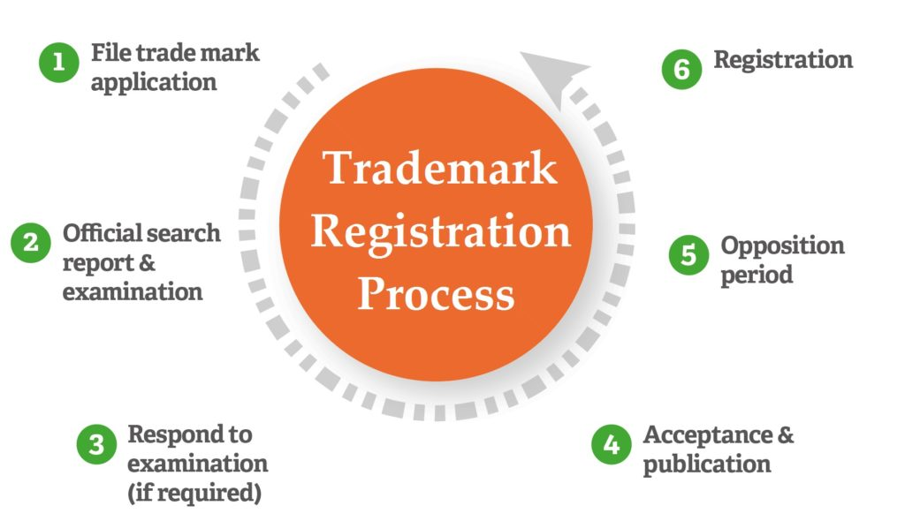
Trademark Registration In India:
Trade and Merchandise Act, 1958 has been repealed and the trademark Act, 1999 passed after taking consideration developments in trading and commercial practices in the country since liberalisation.
The new Act is meant to amend and consolidate the law relating to trademark to provide for registration and better protection of trademark for goods and services and for the prevention of the use of fraudulent trademark.

Slide 31
How to Register?
-> Any person (individuals, corporate bodies, firms) claiming to be the proprietor of a trademark, used or proposed to be used by him, desiring to register it can file an application before the registrar for the registration of his trademark.
Registration:
-> The Controller of Patents, Designs and Trademark, known as the Registrar of trademark appointed by the government is empowered to grant registration for the trademark.
Trademark Registry:
-> The trademark registry established under the old Act of 1958 will be the Trademark registry under this Act.

Slide 32
Electronic Records:
-> The Registrar can keep the records wholly or partly on computer floppies, diskettes and other electronic forms, with the required safeguards. Any entry made in the registers in electronic form shall be deemed to be an entry under the Act.
Location:
-> The Register will be kept under the control and management of the Registrar.
-> A copy of the Trademark register will be kept in the branch offices, besides the documents meant for public inspection notified by the government.
->The register will also contain the existing trademark at the time of the commencement of the Act.

Slide 33
Classification:
-> The Registrar shall classify the goods and services in accordance with international classification of goods and service for the purpose of registration of trademark. Decision by the registrar making such classification will be final.
Index:
-> The goods and services after classification will be entered in the register in alphabetical order. In the event of any omission, the register will determine the error.

Slide 34
When Registration can be Refused
The registration of trademark can be refused under the following circumstances:-
-> If the trademark are devoid of any distinctive character, say, not capable of distinguishing goods from services.
->If they consist exclusively of mark or indication which may serve in trade to designate the kind, quality, quantity, intended purpose, values, geographical origin or the time of production of the goods or rendering of service or the characteristics of the goods or services;
->If they consist exclusively of marks or indication which have become customary in the Current language and bona fide and established practices of the trade. However, a trademark shall not be refused registration if, before the data of application, it has acquired a distinctive character as a result of the use made of it or a well known trademark.

Slide 35
A trademark will not be registered if:
-> it is of such nature as to deceive the public or causes confusion;
-> it contains or comprises any matter likely to hurt the religious susceptibilities
Of any class or a section of the citizens in India;
-> it contains or comprises scandalous or obscene matter;
-> it is prohibited under the Emblems and Names of Great Personalities and Leaders(prevention of improper use)Act.
The other grounds for refusal are if:
->the shape of the goods results from the nature of the goods themselves, or
->the shape of the goods which is necessary to obtain a technical result or the shape which gives substantial value to the good.
->its identify is confusable with an earlier trademark and there is similarity of goods or services covered by the trademark.

Slide 36
Benefits for the Registering a Trademark
It protect company’s name or logo.
It grant to the registered owner the exclusive nationwide ownership of the trademark.
It decrease the chances to claims of infringement being filed by others.
By registering the trademark, a registered owner has the right to indicate the mark as registered thereby indicating that no other person has the right to use that mark.
It increase the chances to filing a suit against infringers.

Slide 37
Infringement of a Trademark
When a registered trademark is used by a person who is not entitled to use such a Trademark under the law, it constitutes infringement;
Instances of infringement of trademark:-
Use of deceptively similar mark.
Use of mark likely to cause confusion because of similarity.
Use of identical or similar registered trademark even on dissimilar goods if the registered trademark has a reputation in India.78
Remedies in case of Infringement:-
An injunction
Either damages or an account of profit.
Order for delivery of infringing levels and marks for destruction.
Damages can be also so be claimed, even if the trade mark is not registered.
This is called passing of action.

Slide 38
Trade Secrets
What is trade secrets?
A trade secret is defined as a secret unknown to competitors that provides a competitive advantage to a business and that is kept secret.
A trade secret may consist of any formula , pattern , device or compilation of information , employee training method , customer database , supplier’s information which is used in the business and which give a firm an opportunity to gain advantage over competitors , who not know ,have or use it.
A trade secret is an item of information that the firm (processing the information) wants to conceal from its competitors in order to prevent them from duplicating it.

Slide 39

Criteria for the information to be called as trade secret :-
It does not fail in the category of general skills and knowledge.
Economic value derived throught trade secret is not being generally known to others.
Economic value derived through trade secret can not be easily obtained.
Trade secrets can be maintained throught the proper efforts on the part of the organization.

Slide 40

Trade secrets under ‘Trips’ :-
Under the TRIPS (Trade-Related Aspects Of Intellectual Property Rights) agreement, ‘trade secrets’ are referred to as ‘undisclosed information’ . “ According to the agreement , an information is a trade secret if :
It is not, as a body or in the percise configuration and assembly of its components, generally known among or readily accessible to persong within the circles that normally deal with the kind of information in question;
It has commercial value because it is secret
It has been subject to reasonable steps under the circumstances, by the person lawfully in control of the information, to keep pt secret. “

Slide 41

Types Of Trade Secrets :-
Technical Information
Production/process Information
Sales and Marketing Information
Internal financial Information
Quality Control Information
Procurements and Materials
HR & Personal
Administrative Information

Slide 42
Evaluation Of Trade secret :-
Following are a few criteria based on which one can decide if the information is to be treated as a trade secret or not :-
The degree of secrecy or knowledge of the those information outside the owner’s business;
The extent to which it is known by those involved in the owner’s business;
The measures taken to guard the secrecy of the information;
The value of the information to the owner or to his/her competitors;
The efforts required to acquire or duplicate the information by others.

Slide 43

When to implement trade Secret Strategy :-
A trade secret strategy is appropriate when your IP is unlikely to result in a registrable right, or if the firm wants to retain exclusive use beyond the term of a patent. Secrecy dies not stop anyone else from inventing the same product or process indepently and exploiting it commercially. It does not give exclusive rights to the firm and it is vulnerable when employees with this knowledge leave the firm. Trade secrets are difficult to maintain over longer periods and when a larger number of employees are exposed to the secret.

Slide 44

Trade Secret Potection Stratagy :-
Designate a trade-secret compliance officer
Include protection in training programs
Limit disclosure of confidential information
Require confidential agreements
Limit the copying of confidential materials
Require immediate return of
all confidential information

Slide 45

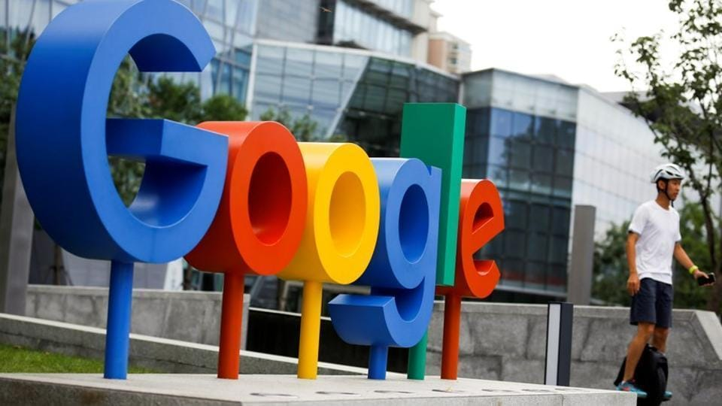
Example:-
Coca-Cola’s recipe for its Coca-Cola is one of the most famous trade secrets in the world. It’s a trade secret because only a select few within the Coca-Cola Corporation know the exact recipe for the soft drink
Google’s algorithm for its search engine is also a very valuable trade secret. Google uses an algorithm that ranks websites based on many factors including inbound links, page rank, relevant text, anchor tags, etc.

